Slide 1
modulo method vs naïve
at naïve we just clip samples that are more than the quantizer edges

Slide 2
mean on MSE
MSE is very noisy, at 2D, because we can get high correlation so we get high MSE if we cannot fins A for this data, or if we need to clip and we get high error.
for example, compare mean MSE to median at the next page

Slide 3
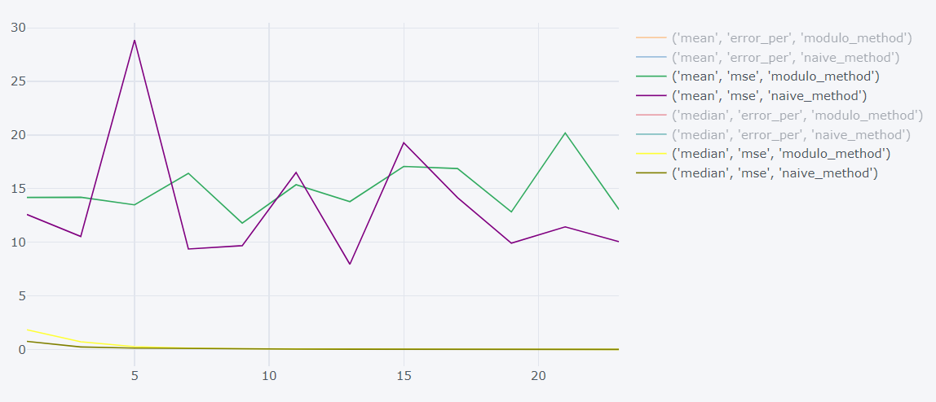
mean MSE vs median MSE

Slide 4
median MSE
we cannot tell anything from it, it only tells us about the original data distribution…

Slide 5
error count
MSE is too noisy, so we can count errors, instead of the square distance

Slide 6
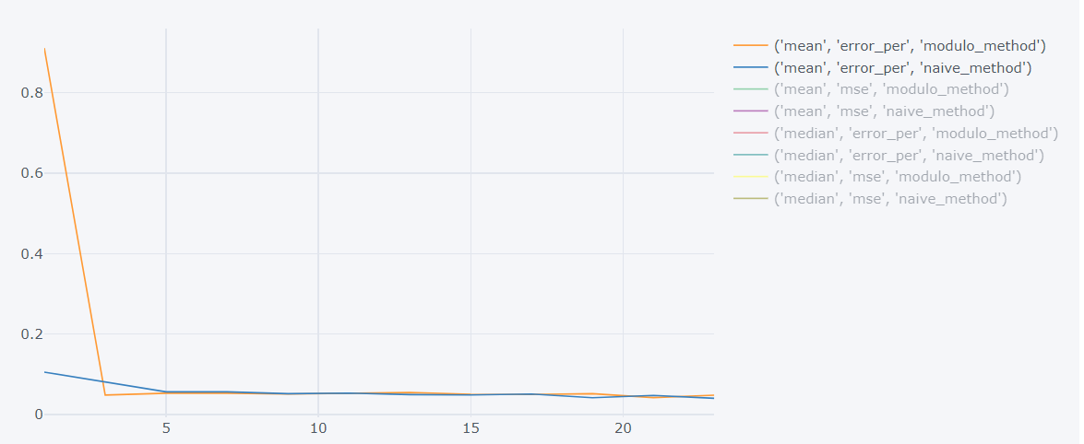
error count mean

Slide 7
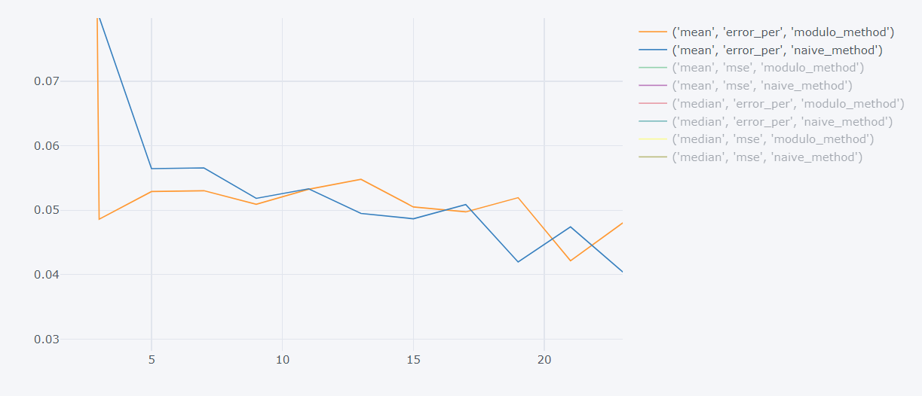
error count mean

Slide 8
error count mean
when we use 10/100/1000 samples, we get the same mean
why?
we expect more samples to give less errors at modulo method
but there are some cases that we cannot solve, so more samples will not help us
so it seems that modulo method can estimate good A by only 10 samples, or we can say that we might get higher or lower estimation but the mean gets the right value.
but at cases that it cannot solve, it will get the errors

Slide 9
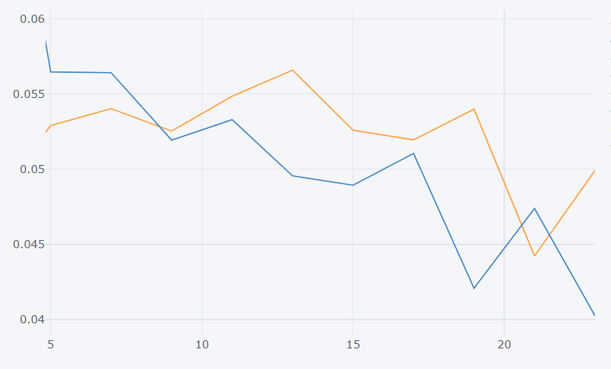
10 samples

Slide 10
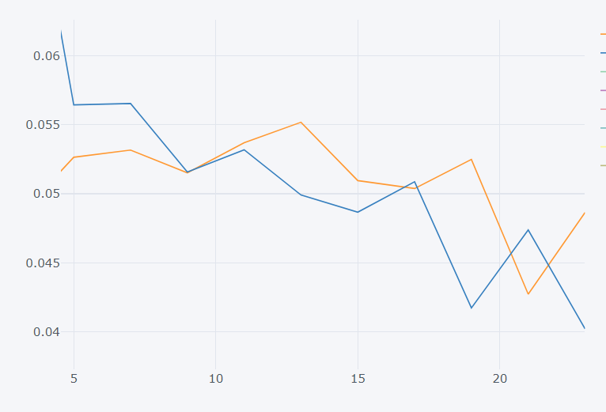
100 samples

Slide 11
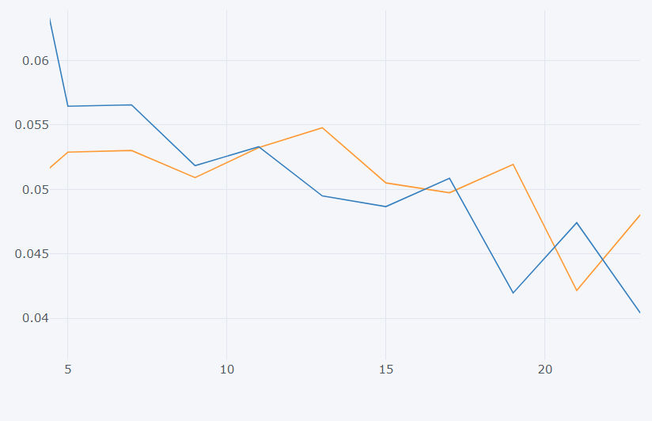
1000 samples

Slide 12
when naïve will be better than modulo
when the data is not highly correlated, there is no need to manipulate it by matrix A, so at some cases the modulo method will think that we need to manipulate it while we don’t and we will just make it worse
but by showing that we have the same graph at 10/100/1k samples, we can tell that we don’t have bad estimation of the covariance
another case is if we have highly correlated data, and we cannot fix it, we better do clipping rather than multiply in A
the only case that modulo will be better is when we have data that matches A, and this cases is not common by how we random the data covariance…

Slide 13
conclusions
we don’t have much cases that A fixes the data
so we better use naïve method rather than modulo

